Slide 1
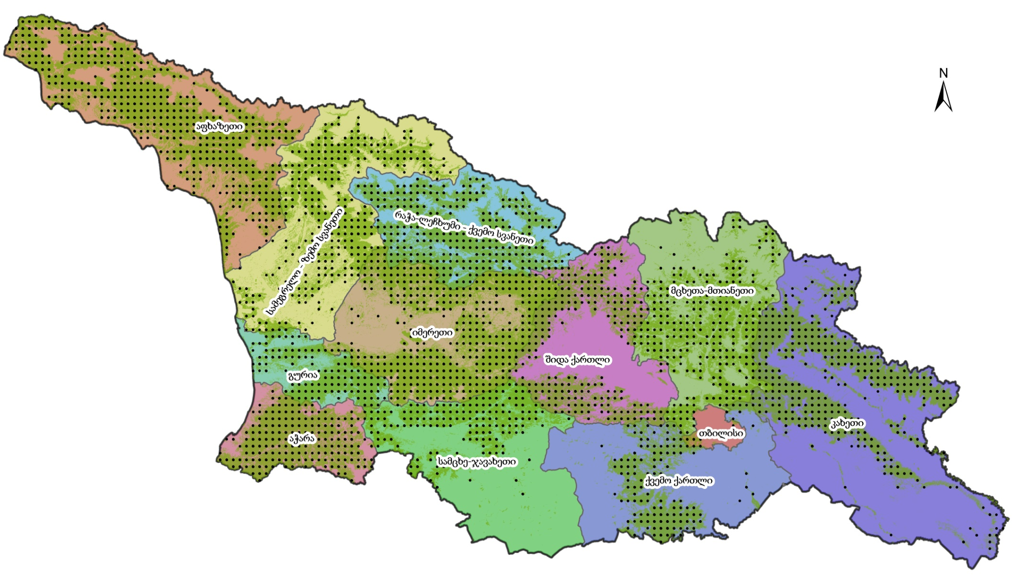
Georgian National Forest Inventory
Experiences in implementing National Forest Inventories, considering war impacts
Paata Torchinava – Forestry Officer, Ministry of Environmental Protection and Agriculture of Georgia
31.10.2023

Slide 2
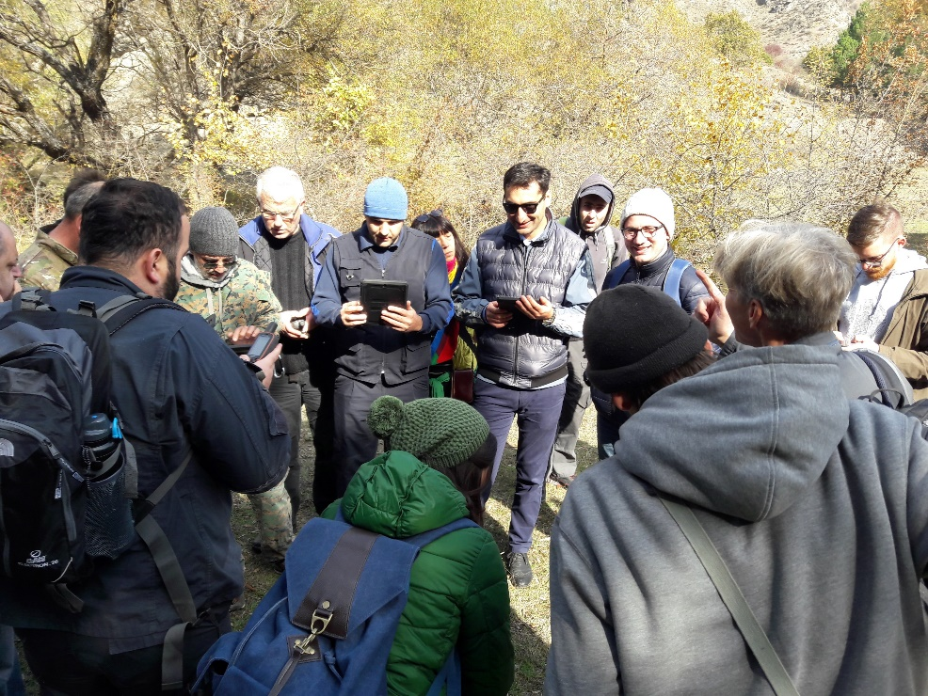
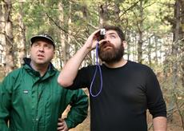
National Forest Inventory
Ministry referred to the German government (2015)
Verbal Note, Memorandum (2017)
Task force (June 2017)
Changes in legislation

Slide 3
Importance and Goals of National Forest Inventory (NFI)
• Obtain updated information on qualitative and quantitative characteristics of Georgia’s forests.
• Establish permanent sampling network for continuous monitoring of forest characteristics.
• Provide reliable information to those making political and strategic decisions.
• Report at the national, regional and international levels.
• Promote scientific research and strengthen research institutions.

Slide 4
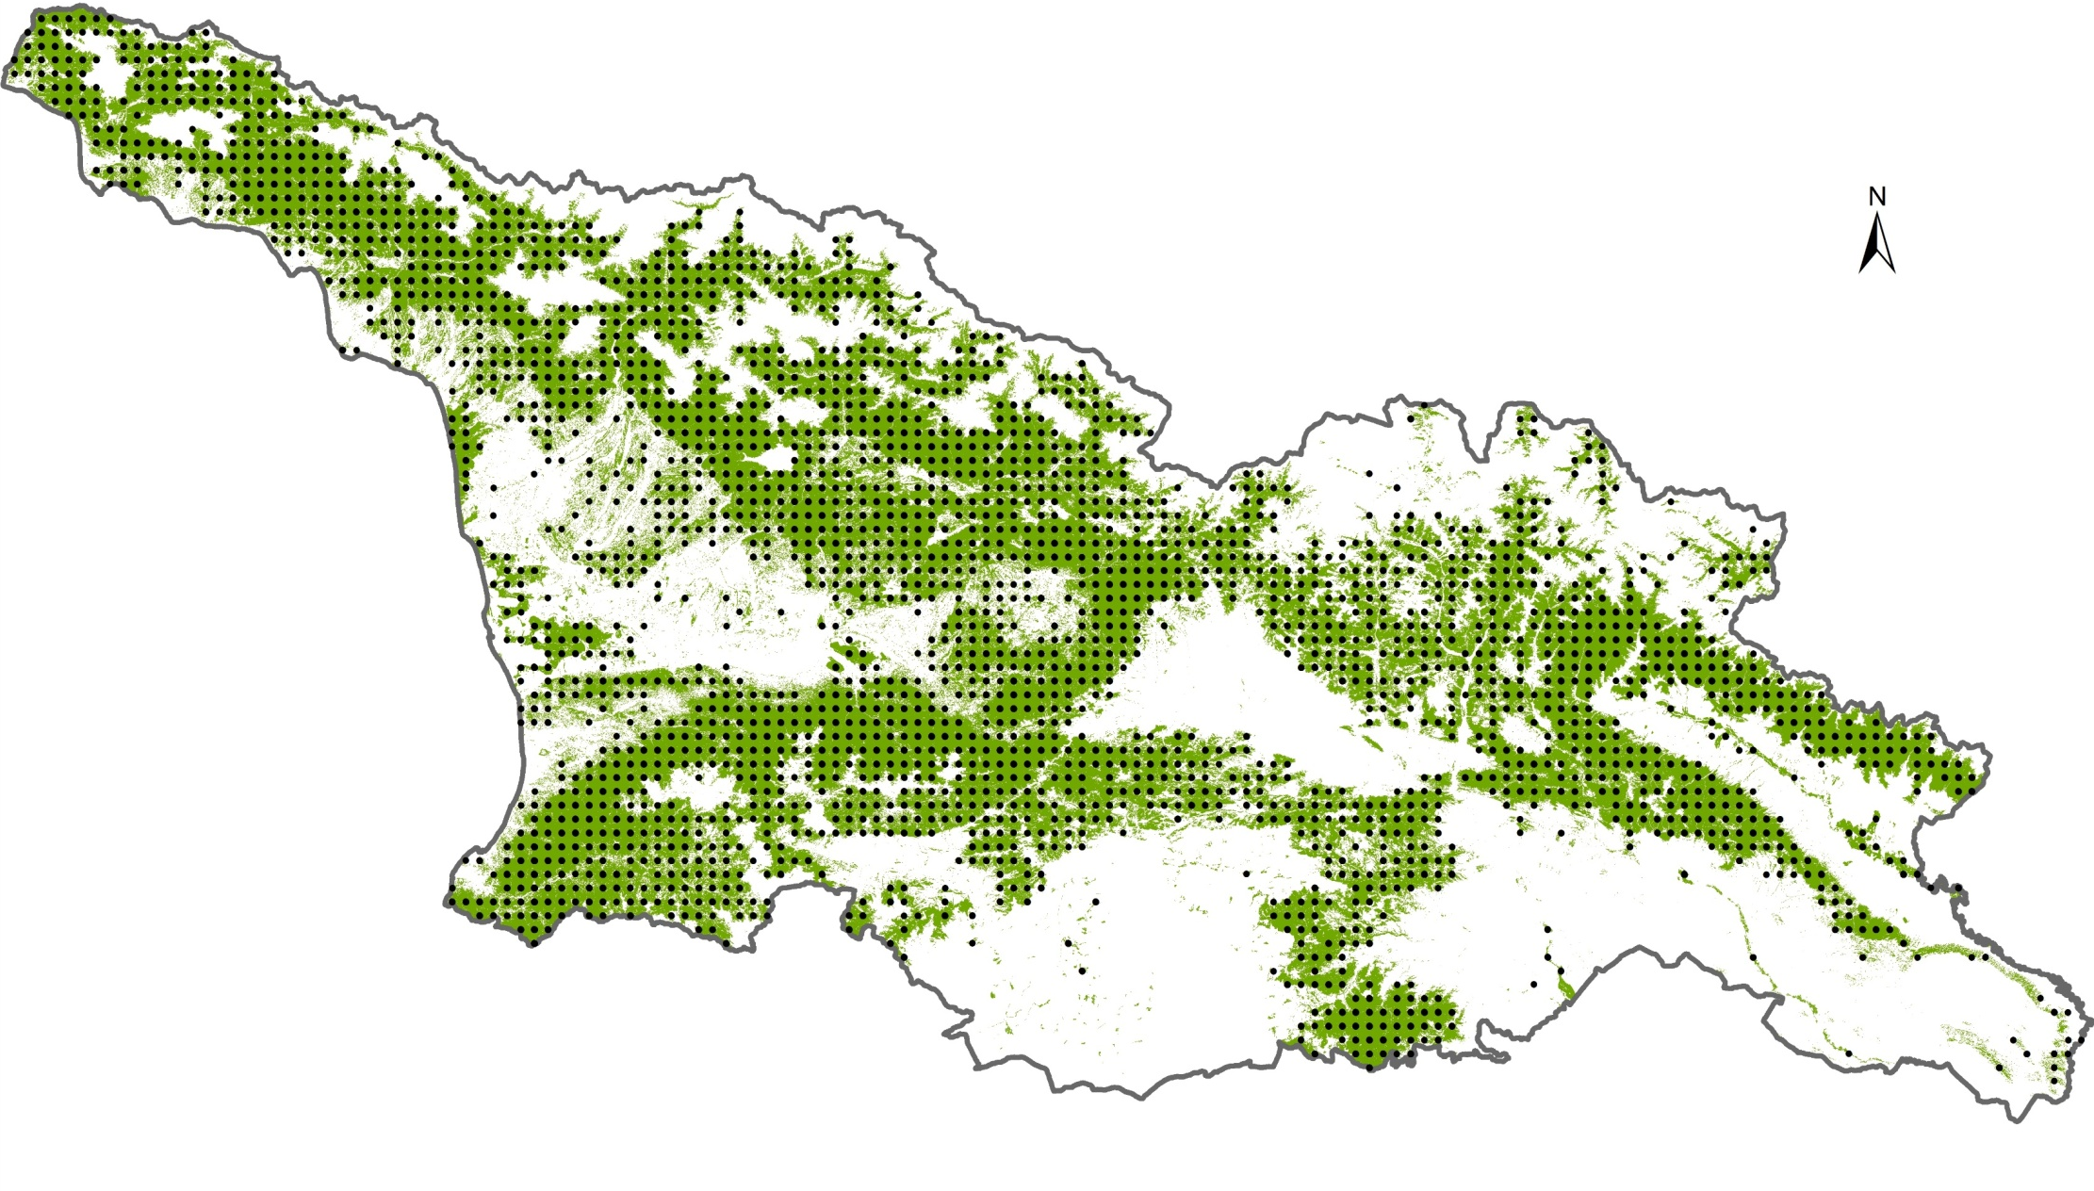
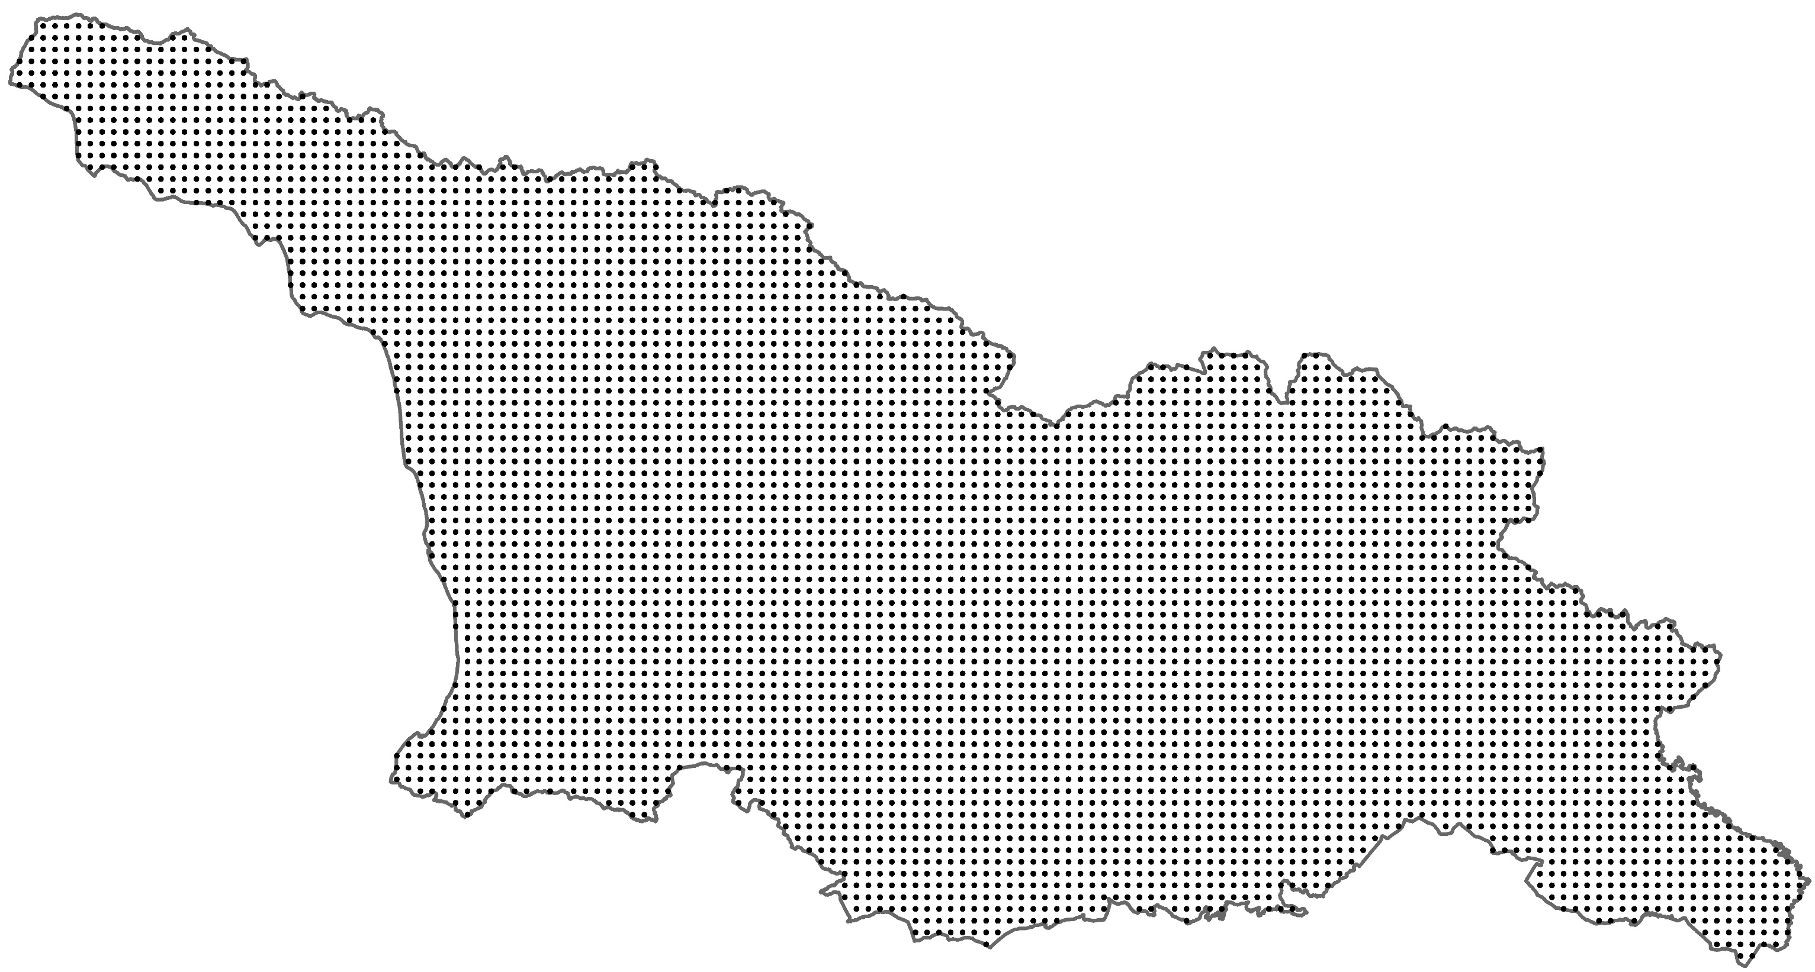
National Forest Inventory Research Area
NFI grid size: 3.6 x 3.6 km
- 5375 cluster
- 2702 cluster

Slide 5
Preparatory work
National Forest Inventory documents
Informational needs
(Ministry)
Technical details of national forest inventory methodology(protocol)
National forest inventory field guide
FAO – “Open Foris“ module methodology
Manual on field work equipment usage
Field group training modules
Field work control methodology
NFI Terms of Reference (TOR)

Slide 6
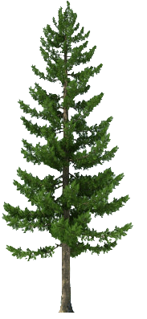
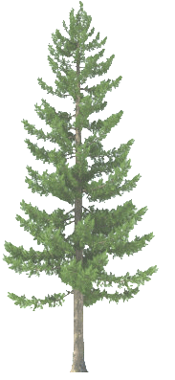
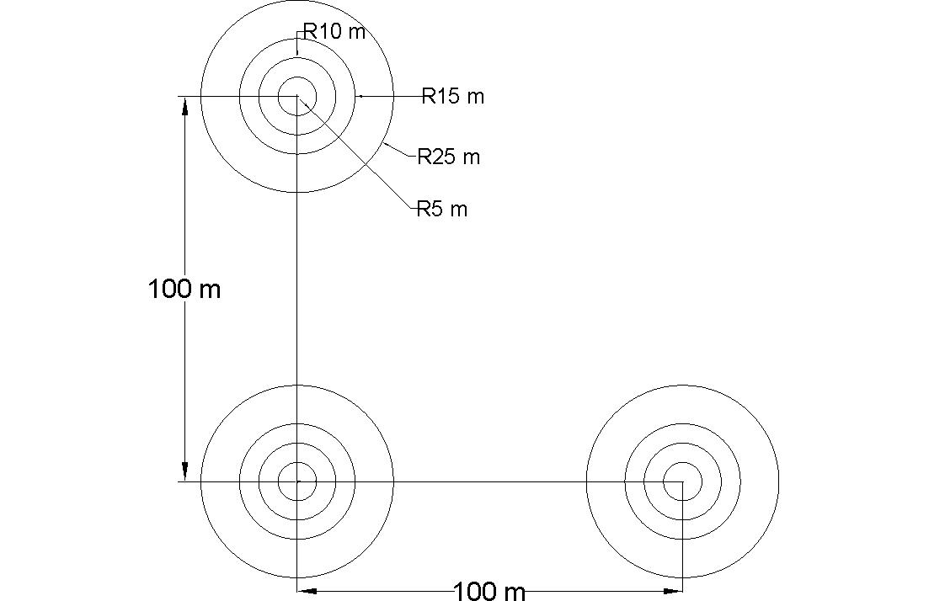
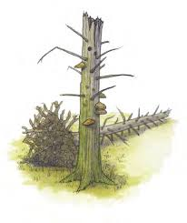
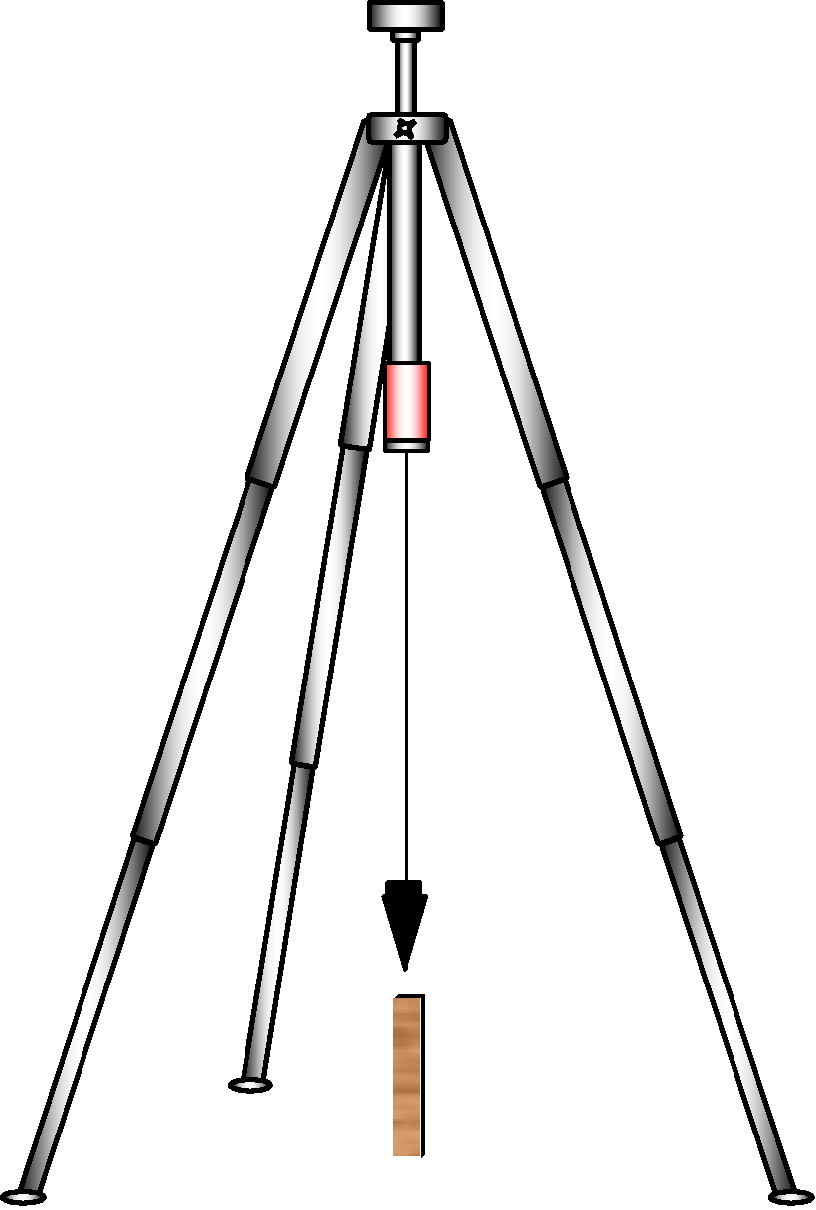
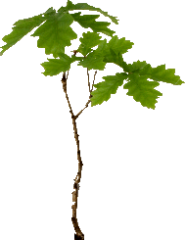
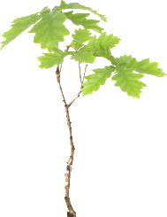
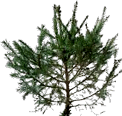
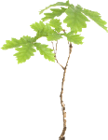
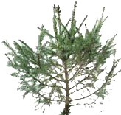
NFI cluster and sample plot design
NFI grid size: 3.6 x 3.6 km
A cluster consisting of 3 sample plots
Sample
Plot

Slide 7
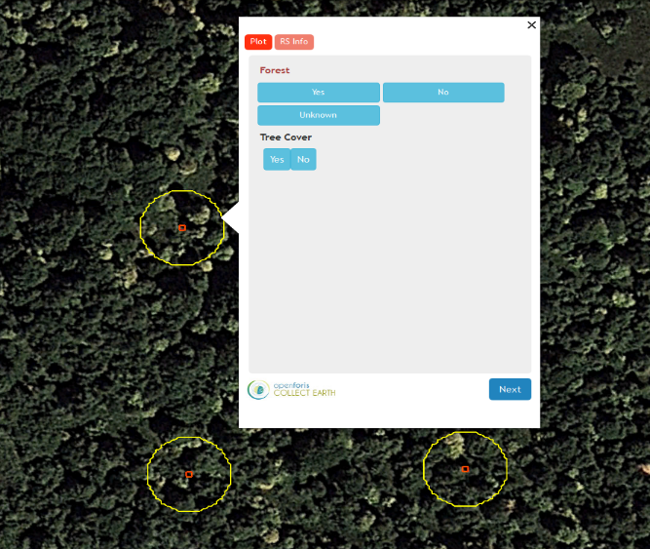
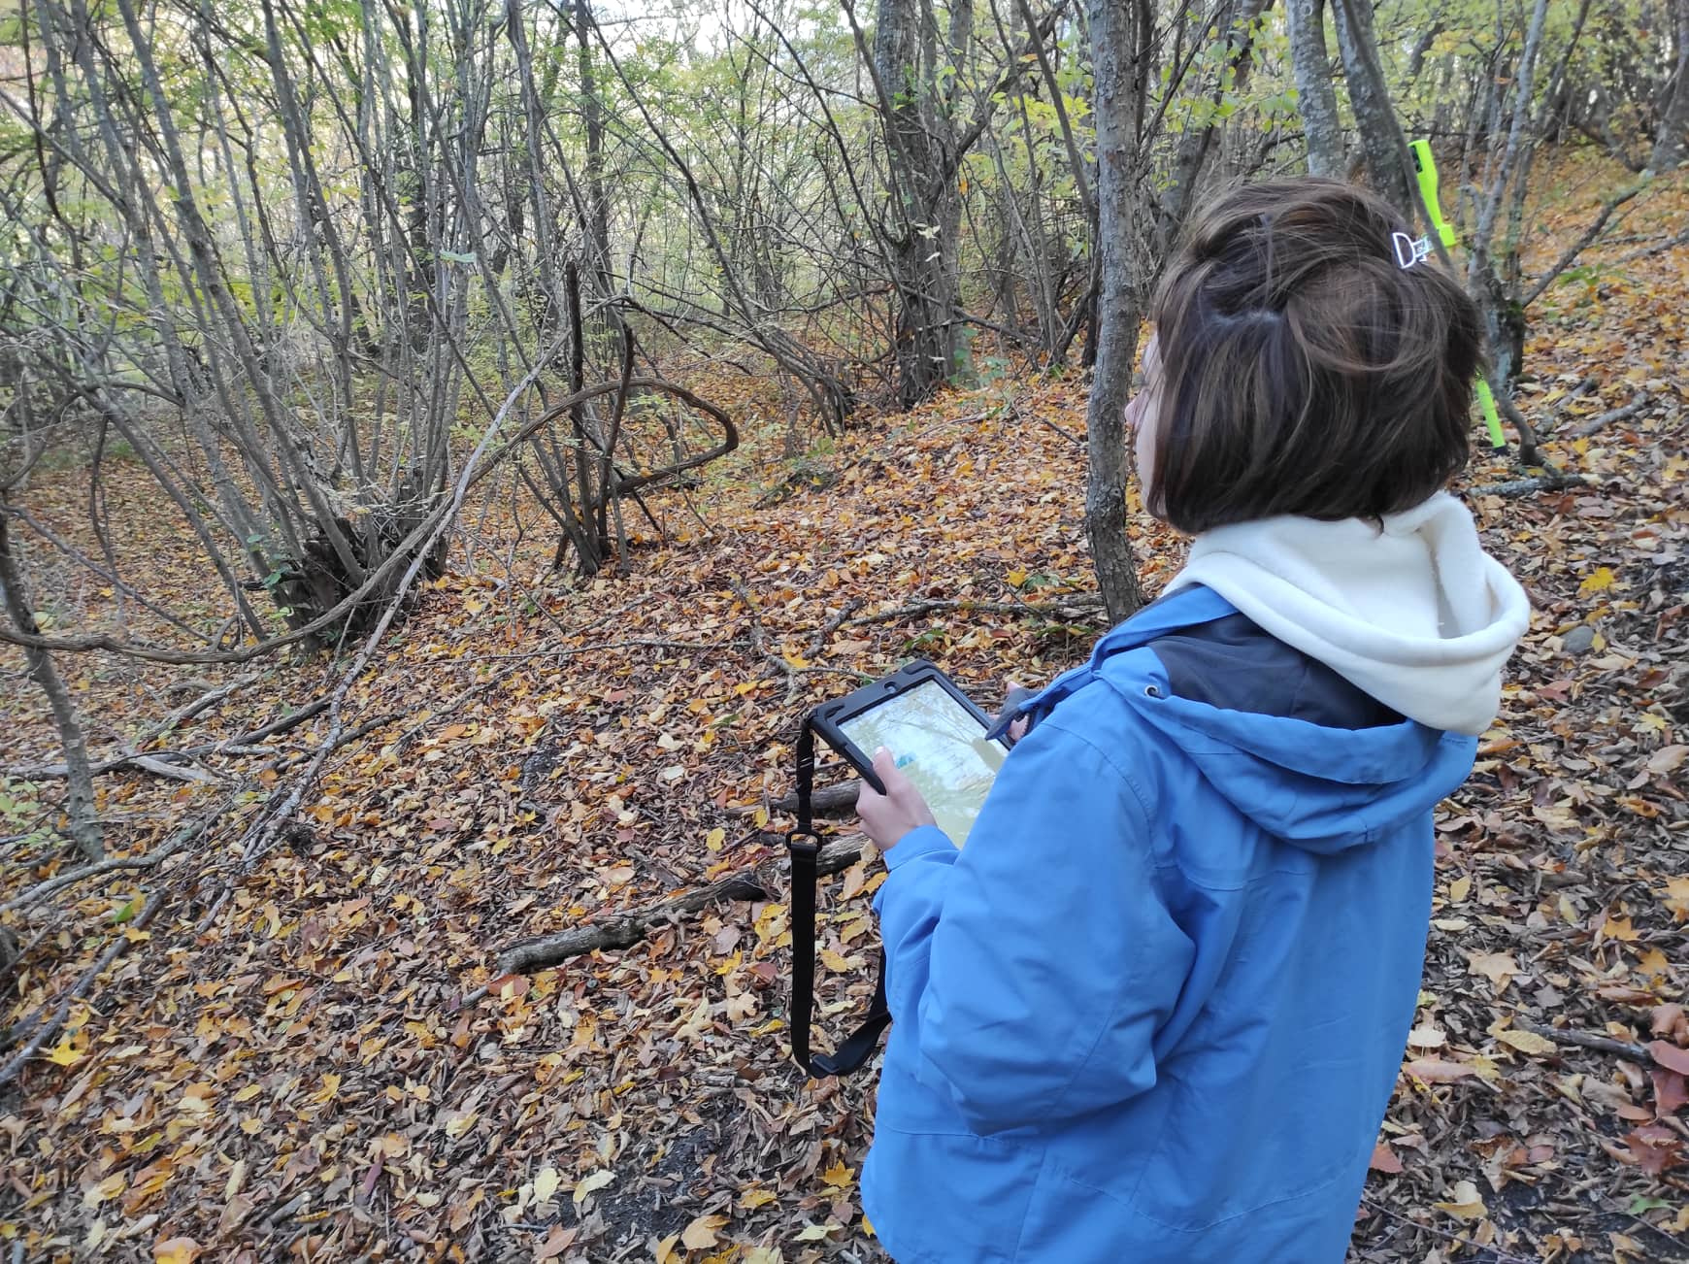
NFI data collection and analysis
(Software support)
Open Foris - A free platform of tools and methods for data collection and analysis
„Collect Earth“ -Preliminary evaluation of clusters
„Collect Mobile“ -Collect data in the field
„Collect“ - Management of information collected in the field
„Calc“ – Data Analysis
http://www.openforis.org

Slide 8
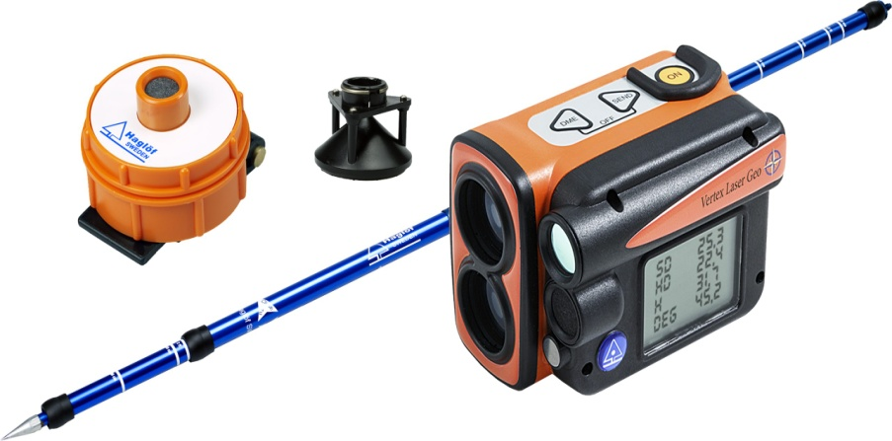
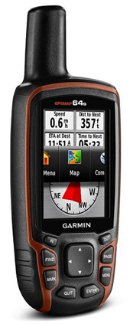
Field equipment
Tablet
Vertex Laser GEO
Increment borer
Diameter-measuring tape
Calliper (for diameter measurement)
GPS

Slide 9
Field Works
2019 | Number of clusters
Total: 441 | 441
2020 | Number of clusters
Total: 871 | 441
2021 | Number of clusters
Total: 707 | 441
During the National Forest Inventory, a total of 2019 clusters were assessed in Georgia
Number of sample plot - 5282
Temporarily occupied territories
Notes:
ქვეყნისთვის მნიშვნელოვან გამოწვევად რჩება საქართველოს დროებით ოკუპირებულ ტერიტორიებზე და საოკუპაციო ხაზის გასწვრივ (აფხაზეთისა და ცხინვალის რეგიონი) უსაფრთხოების კუთხით არსებული ვითარება, სადაც საველე მონაცემების ადგილზე შეგროვება შეუძლებელია. ამ პროცესში აღნიშნულ ტერიტორიებზე ტყის რესურსებზე დაკვირვებისა და მონაცემთა შეგროვების წყაროს დისტანციური ზონდირების ინტეგრაცია წარმოადგენს.
ტყის ეროვნული აღრიცხვის განხორციელების საწყის ეტაპზე, სანიმუშო ფართობების (კლასტერების) წინასწარი იდენტიფიცირების შედეგად (ტყე/არა-ტყე) დადგინდა, რომ:
დისტანციური ზონდირების შედეგად დადინდა, რომ საქართველოს ტყის 680,7 ათასი ჰა. (22,6%), საიდანაც ტყით დაფარულია 642.1 ათასი ჰა. ფართობი, მოქცეულია დროებით ოკუპირებულ ტერიტორიებზე. მათ შორის: აფხაზეთის ტყის ფართობია - 507,1 ათასი ჰა., მ.შ. ტყით დაფარული - 479,9 ათასი ჰა; ცხინვალის რეგიონის (ყოფილი სამხრეთ ოსეთის ავტონომიური ოლქი) ტყის ფართობია - 173,6 ათასი ჰა, მ.შ. ტყით დაფარული - 162,2 ათასი ჰა.
შედეგად სამინისტრომ დაიწყო მუშაობა და საქართველოს ტყის საზღვრებში შემოიყვანა აფხაზეთის ტერიტორიაზე არსებული ტყეები

Slide 10
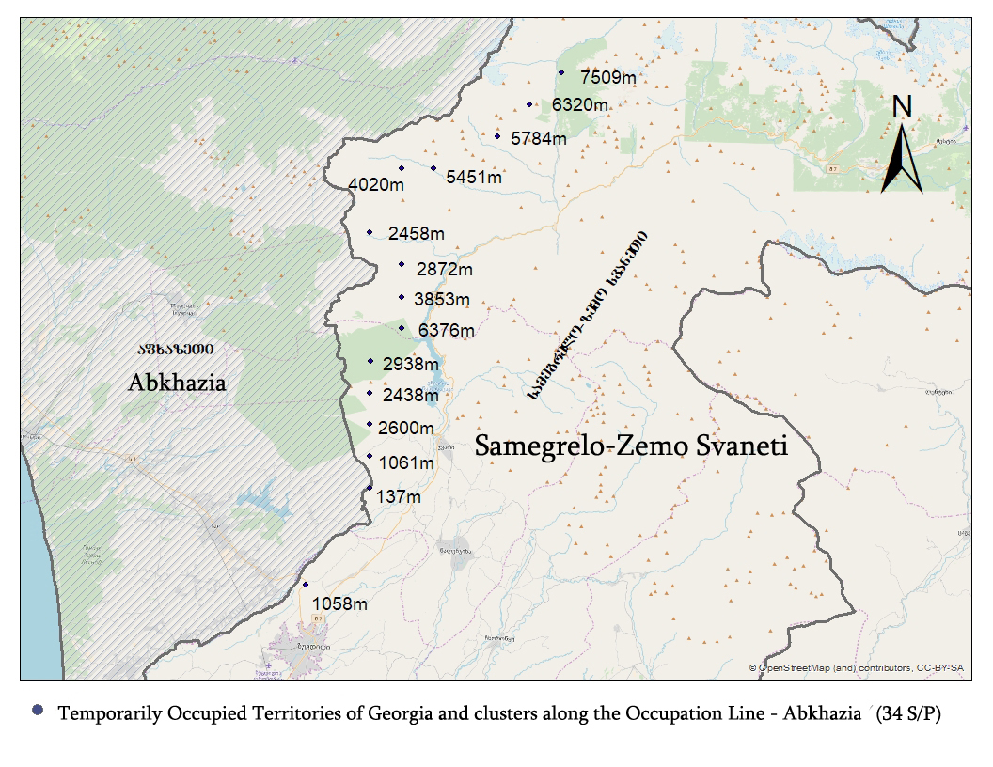
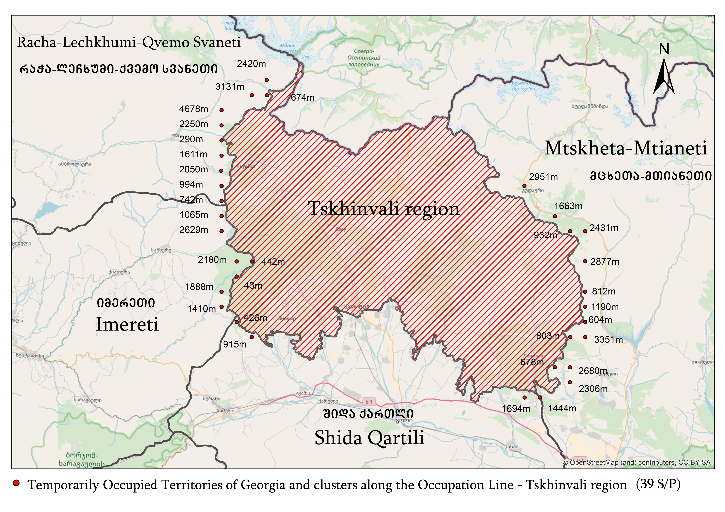
Field Works
Inaccessible forest areas (occupied territories)
1278 sample plots are located on the territory of Abkhazia AR, while along the occupation line on territory controlled by the Central Government of Georgia, there are a further 34 sample plots
490 sample plots are located on the territory of the Tskhinvali region while along the occupation line on the territory controlled by the Central Government there are a further 39 sample plots
Notes:
An important challenge for the country remains the security situation in the temporarily occupied territories of Georgia and along the occupation line (Abkhazia and Tskhinvali region), where it is impossible to collect field data.
In advance communication with the office of the state Security Service.
In this process, the integration of remote sensing is a source of data collection and observation of forest resources in the mentioned areas.
At the initial stage of implementation of the national forest inventory, preliminary identification of sample areas (clusters) (forest/non-forest) was carried out.
Since the fieldwork could not be carried out on temporarily occupied and adjacent territories for security reasons, remote sensing was used to determine the area covered by forests. It was found that 24.5% (759 200 ha) of Georgia’s total forest cover is located on temporarily occupied territories: 547 600 ha in Abkhazia
and 211 600 ha in Tskhinvali region.
Including areas adjacent to the temporarily occupied territories, 818 000 ha (26.4%) of the forest was subject to remote sensing instead of fieldwork.
As a result, the Ministry started working and brought the forests in the territory of Abkhazia to the forest borders of Georgia

Slide 11
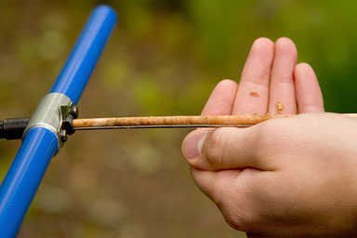
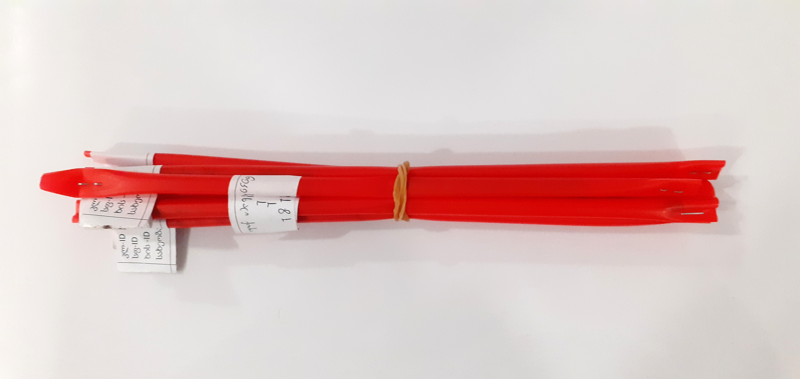
Involvement of Scientific Research Institutes
20 students were employed
A total of 13 356 boreholes were analyzed
Drill samples
Agricultural University
Ilia State University
Notes:
შეირჩა 2 უნივერსიტეტი, აგრალური და ილიაუნი რომლებიც აღიჭურვნენ შესაბამისი ინვენტარით და მოახდინეს ნაბურღი ნიმუშების გაანალიზება

Slide 12
National forest inventory results

Slide 13
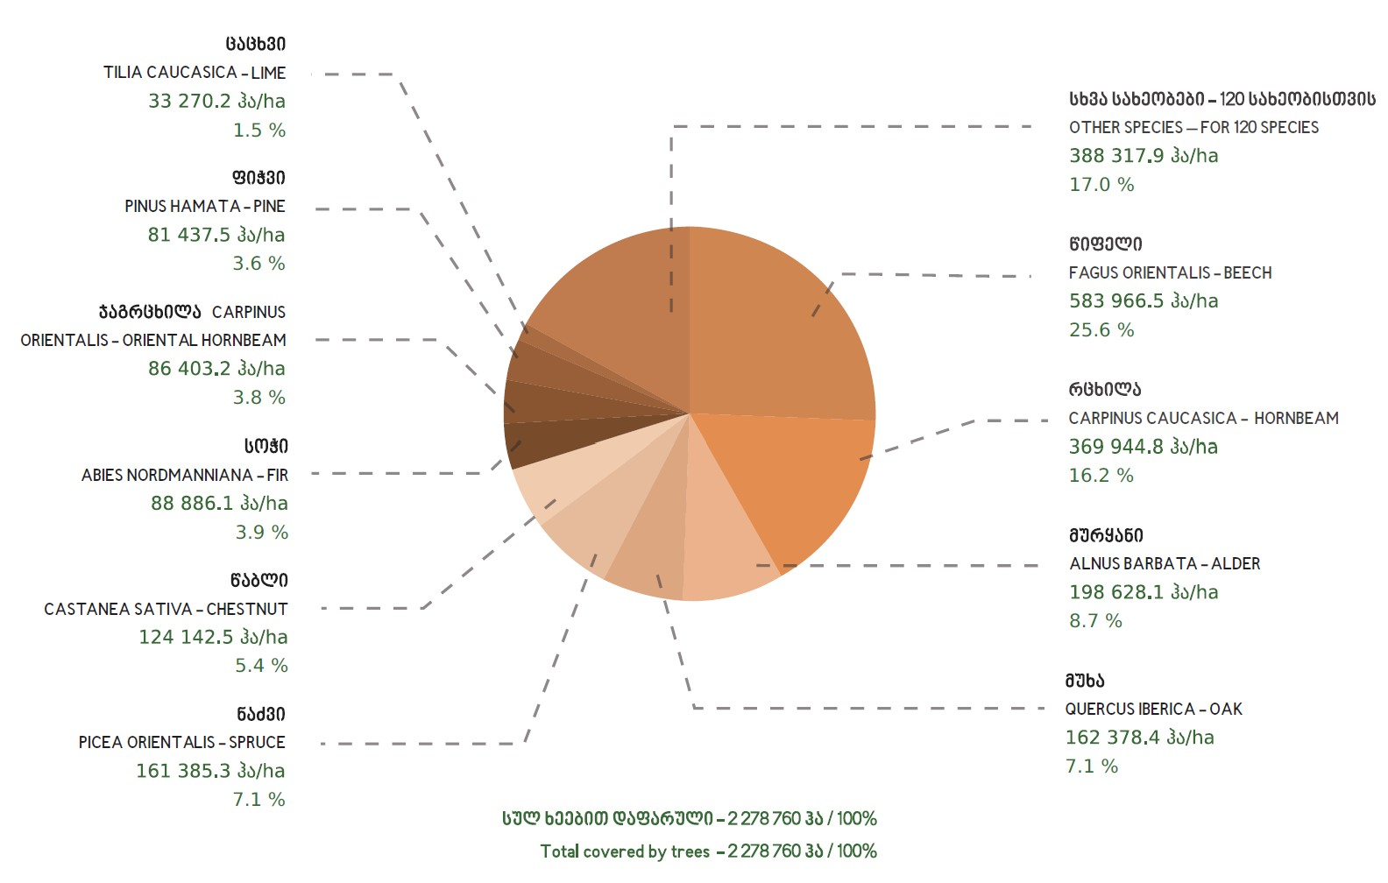
The main types of forest
Distribution of forests by tree species

Slide 14
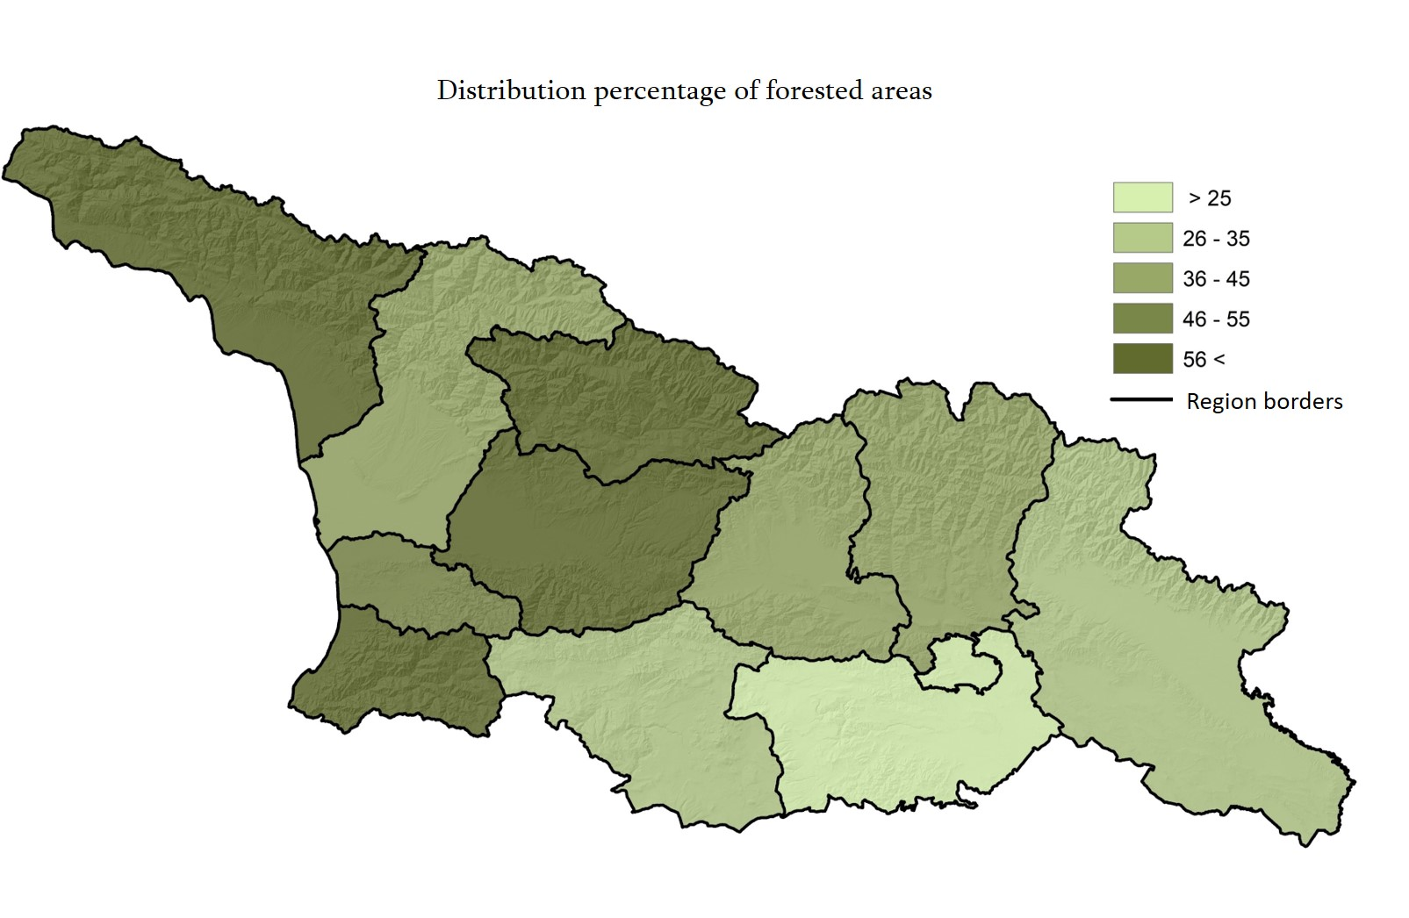
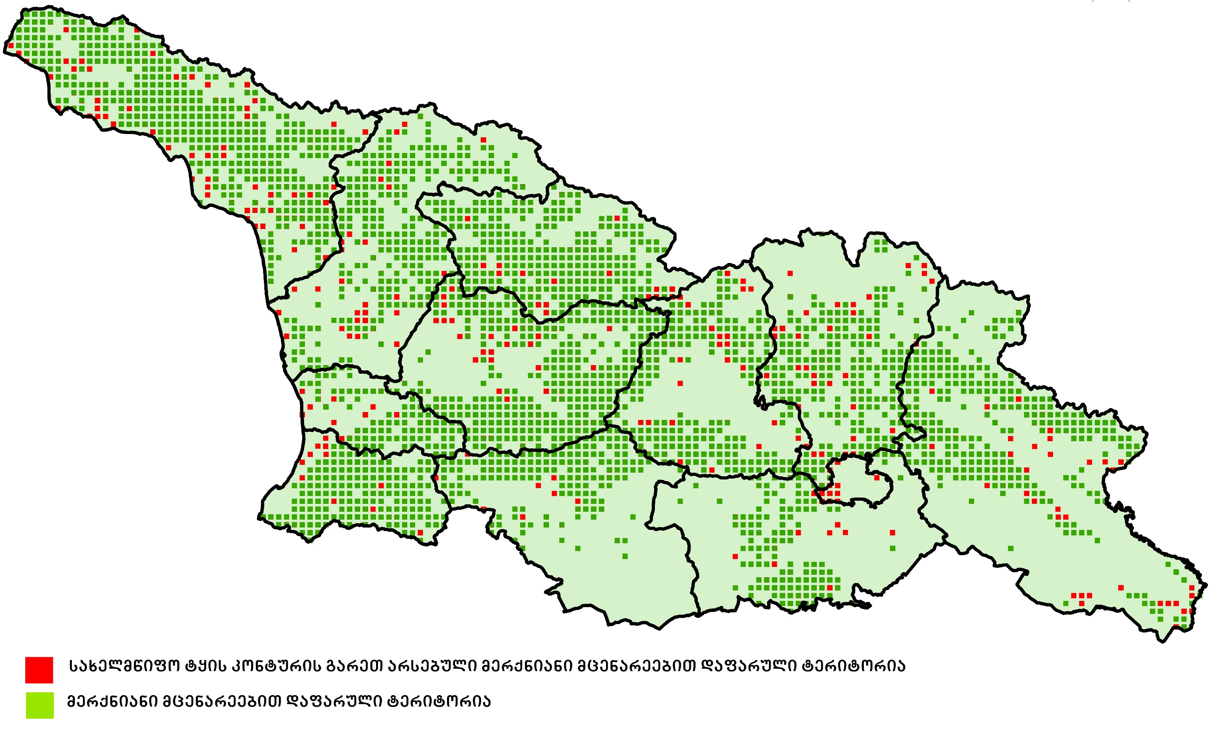
Distribution percentage of forest area
wood species
Covered area - 3,096,700 ha
(of the country - 44.7%)
Existing in the contour of the state forest
with woody plants
Covered area - 2,669,700 ha
Area covered with wood species
(outside the state forest contour) 427,000 ha
Area covered by woody plants outside the state forest contour
Area covered with woody plants

Slide 15
Percentage distribution of the main woody species
According to stocks and areas
Average taxation data per ha
Tree volume | 700
Diameter - DBH (cm) | 19.9
height (m) | 15.3
Age (year) | 75
Site index (Bonitet) | IV
Wood stock per ha - 231 m ³
Total stock - 528.2 Million m³

Slide 16
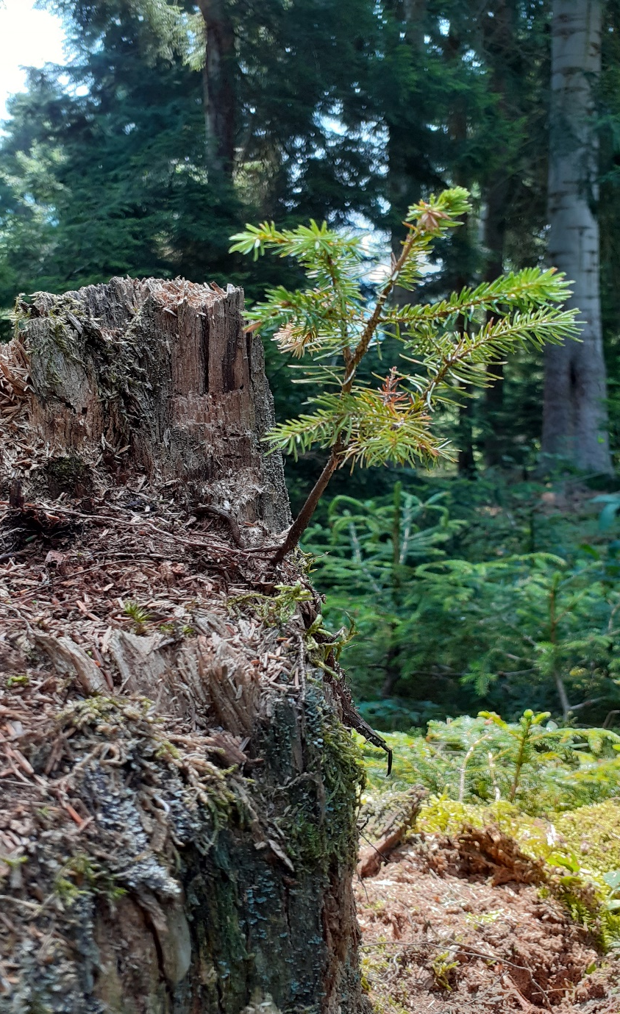
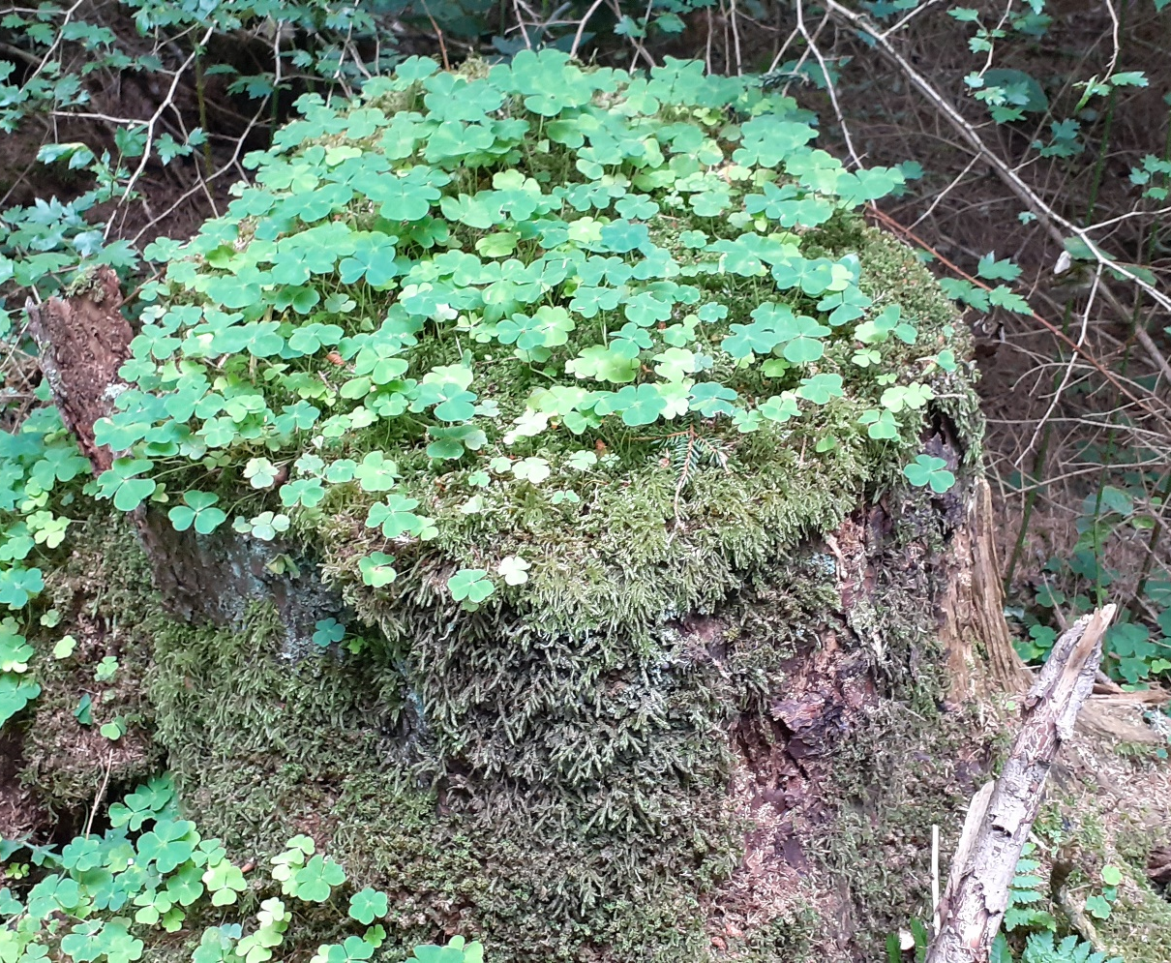
Biodiversity
On average, the stock of dry wood per hectare is 21 cubic meters
On average, 25% of trees per ha are "habitat trees"

Slide 17
Forest degradation
From the data of the national forest inventory, it is clear that a significant part of the area covered by forests - 807,178 hectares (34.5%) is degraded
Distribution percentage of degraded areas by category
Low density stand – 38.8%
Forest quality reduction by illegal cutting – 36.1%
Phyto and ento – 15.6%
Grazing – 7.8%
Forest damaged by fire – 1%
Other – 0.7%
Soil erosion processes are frequent - soil erosion is recorded on 643,678 hectares (28.2%) of the forest area.

Slide 18
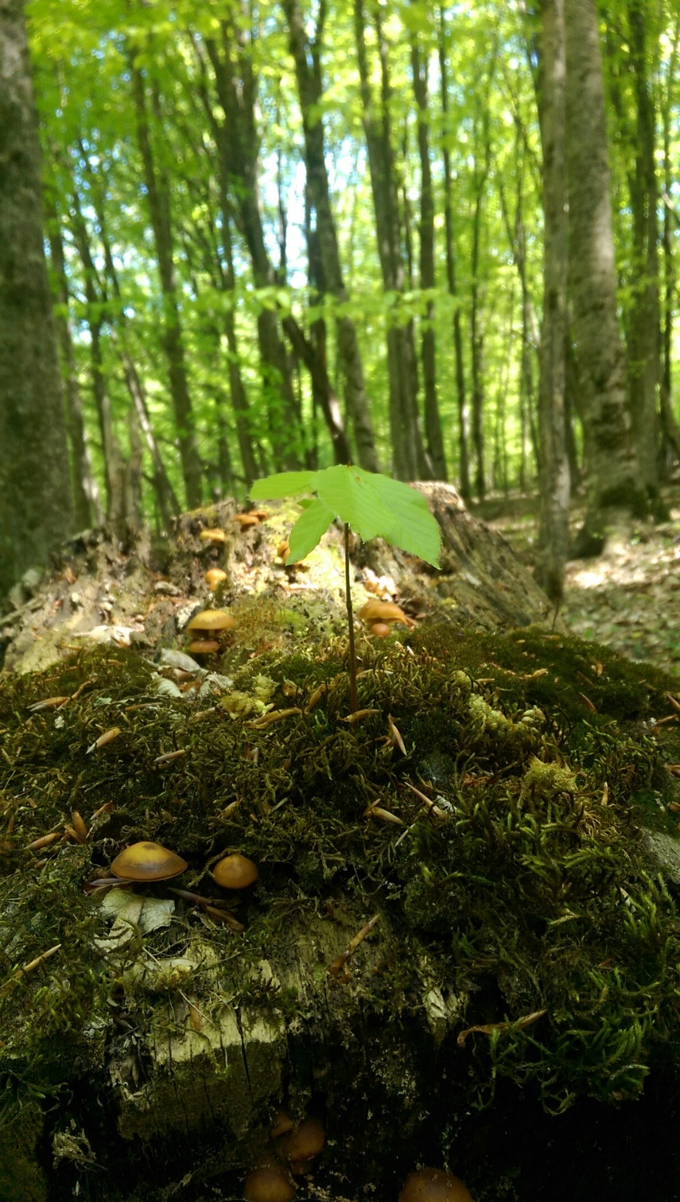
Forest Regeneration Potential
Current wood growth is 6 cubic meters on 1 ha

Slide 19
Major Future Perspectives

Slide 20
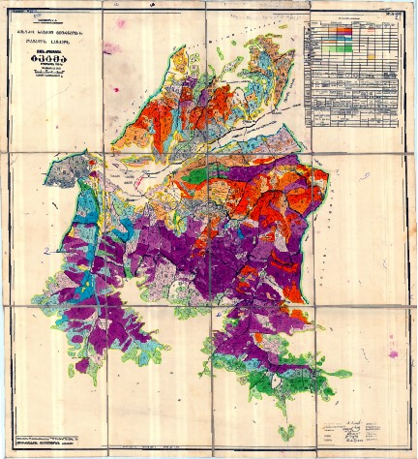
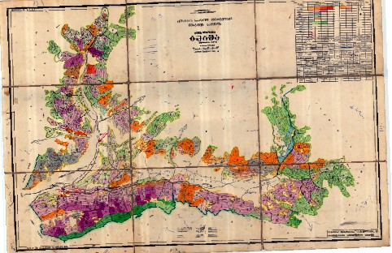
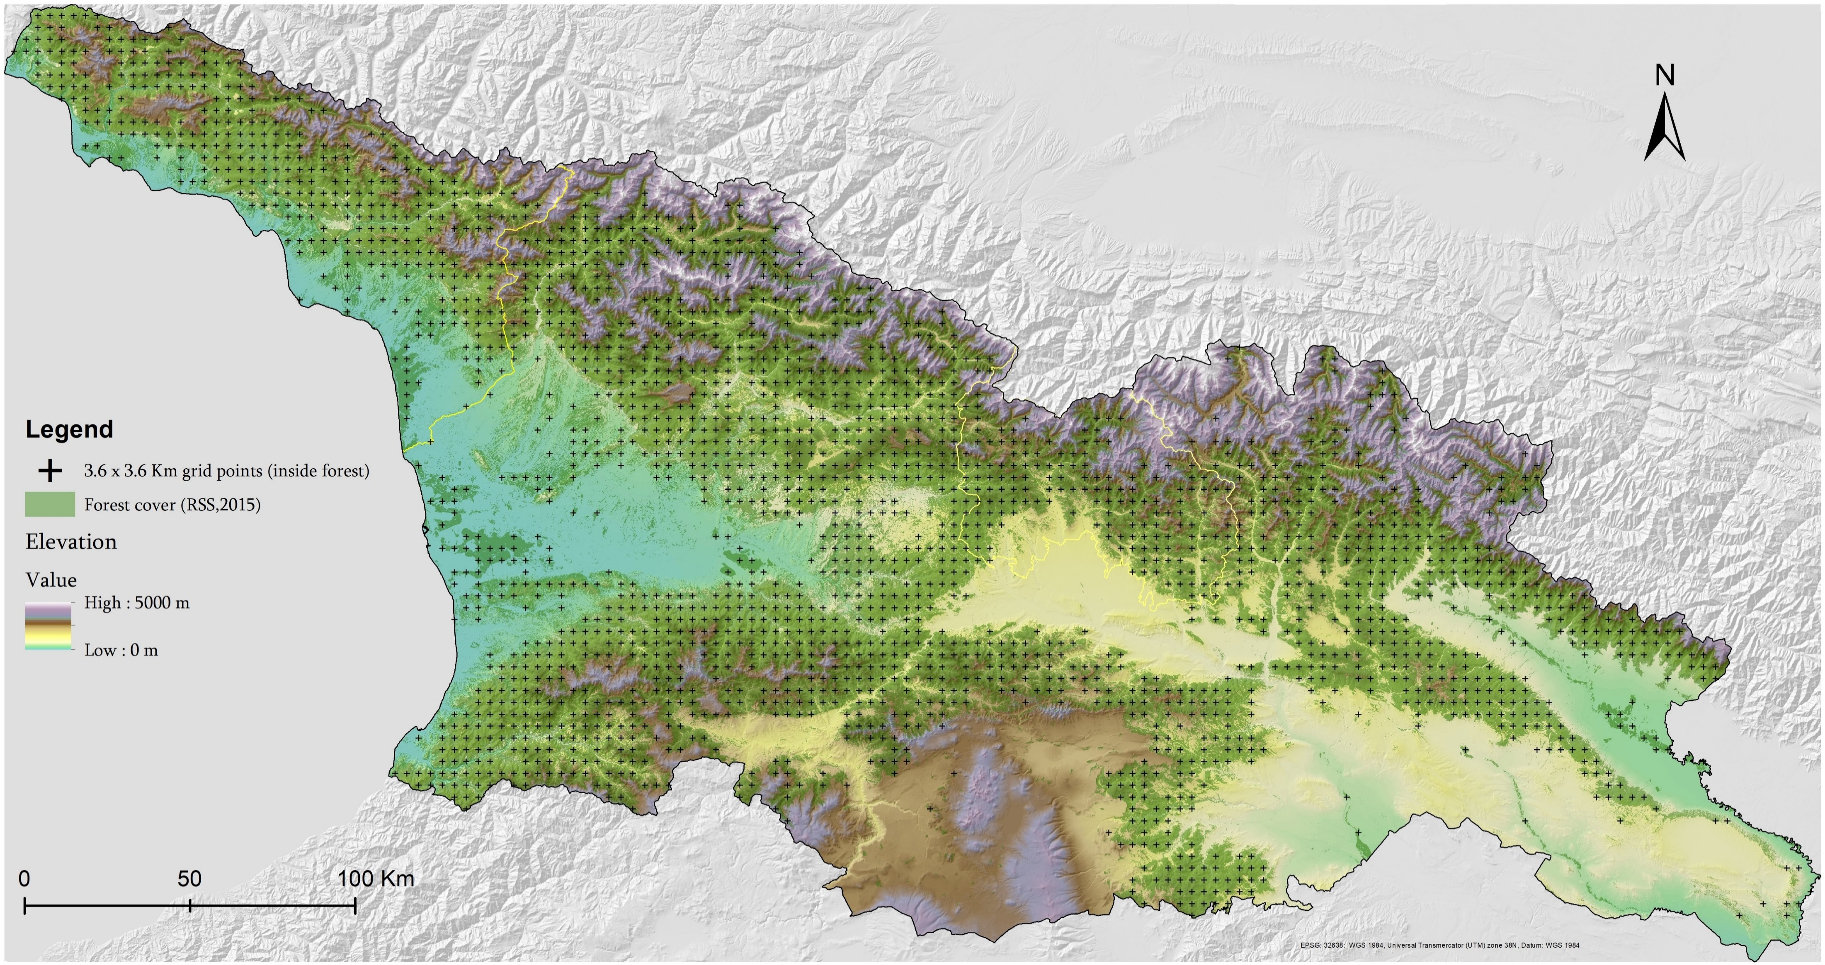
Forest in the Temporarily Occupied Territories of Georgia
Stand Map

Slide 21
Continuous Forest Monitoring
Planning and executing the next cycle of the National Forest Inventory (NFI)
Observation of ongoing changes in the forest
Assessing the political decisions were made

Slide 22
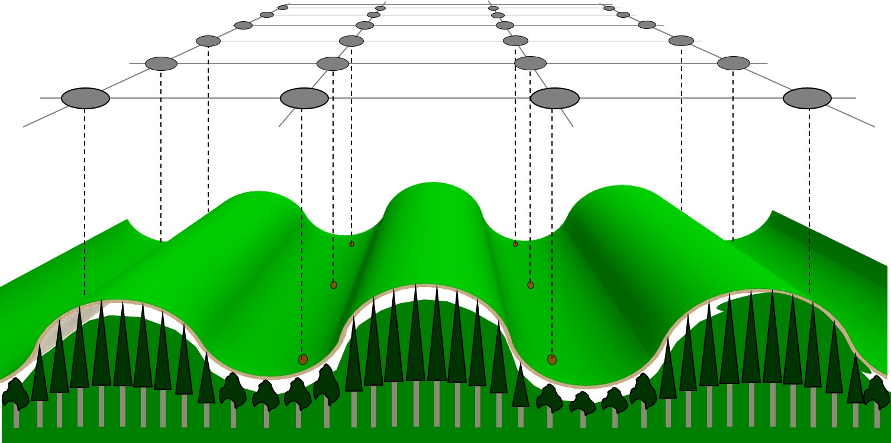
Thank you for your attention

